Slide 1
Digital Negatives by George L Smyth
An Example

Slide 2
Digital Negatives
More complete information,
As well as this document,
can be found at
http://glsmyth.com/
in the Articles section.

Slide 3
Digital Negatives
Some Advantages of digital negatives
Ability to shoot digitally, yet process with analog tools
Ability to correct film negatives with imperfections
Ability to alter the contrast of a film negative for various processes
Ability to use Photoshop to make changes impossible in the darkroom
No more wasting paper with test strips
More efficient time spent in the darkroom

Slide 4
Digital Negatives
Some disadvantages of digital negatives
Any change in materials (paper, developer, process, etc.) or workflow requires new testing

Slide 5
Digital Negatives
Let’s get started

Slide 6
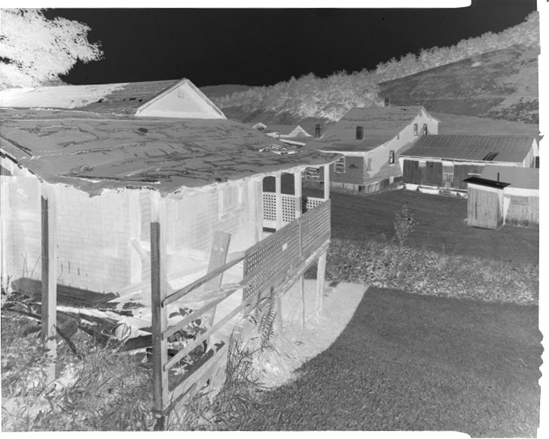
Digital Negatives
It would be reasonable to assume that one merely need to invert an image, print it on a clear substrate, and use that as the negative. This only works if you do not care about the results.
To see what happens when this is done, I scanned a negative.

Slide 7
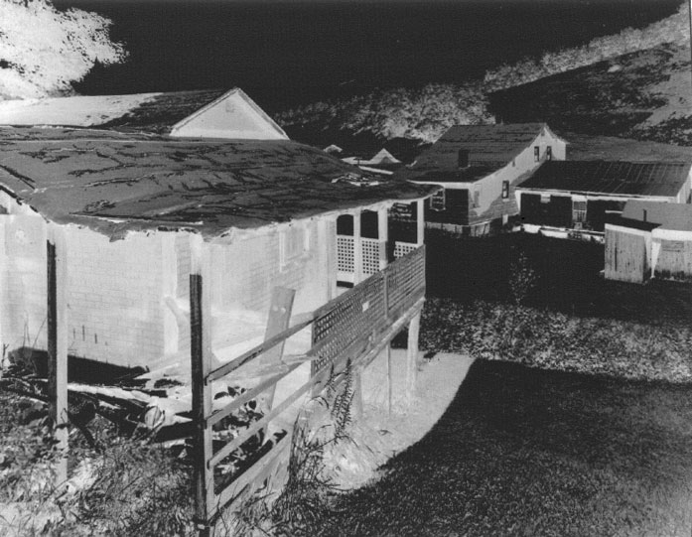
Digital Negatives
I inverted the negative to show the image, did some burning and dodging, and removed some dust spots. I inverted the negative and printed it onto Pictorico transparency paper.
I then took the negative into the darkroom and made my print.

Slide 8
Digital Negatives
The kind thing would be to say that the print’s tonality did not reach expectations.

Slide 9
Digital Negatives
On second thought, this is to be expected. Film has a characteristic curve that is not linear, and it works with a paper’s characteristic curve to produce a proper range of tonality. When a digital negative is created the curve is linear, which does not match properly with the paper.
To address this issue, a curve needs to be applied to a digital negative that matches the paper – this is nothing new, zone system photographers have been doing this for years with film.

Slide 10
Digital Negatives
This presentation describes how I go about preparing an image so that it can be turned into a digital negative. My goal is to establish a sequence for Slavich Unibrom 160 paper, which is very nice for use in the Bromoil process, but as of this writing is no longer available in the United States. As I do not want to waste any of my remaining stock by making test strips and testing burning and dodging attempts, employing digital negatives is the obvious solution.
The following is a description of that process. This exact process can be applied to preparing a system to deal with alternative processes, like Cyanotype or Platinum printing.

Slide 11
Digital Negatives
There are three issues that need to be addressed when building a system for digital negatives.
Determining the minimum exposure time
Determining the color of the negative
Building a curve
I address these one at a time.

Slide 12
Digital Negatives
Determining the Minimum Exposure Time
The purpose of silver in a negative is to block the light of the enlarger. The purpose of printer ink is to impregnate paper with ink. My guess is that printer ink actually does a reasonable job of blocking the ultraviolet light used when exposing paper with Cyanotype or Platinum sensitizer, but it does not work very well when blocking light from an enlarger. This means that, like slide film, there is little leeway when it comes to exposure.
When making digital negatives to be used with silver gelatin paper I use Pictorico Ultra Premium OHP Transparency Film because it appears to hold more ink (thus greater light-blocking capabilities) than other transparency films. If one is making a digital negative for an alternative process then its less expensive version can be successfully used.

Slide 13
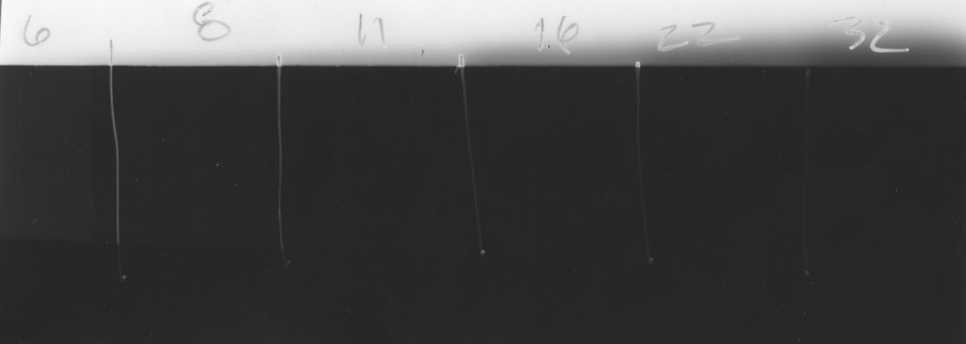
Digital Negatives
To determine the minimum exposure time, I expose a test strip through the transparency film.
After exposing each segment I cover the strip with matt board so that just the bottom is showing, then I turn on the lights for several seconds. This allows me to compare the strip against the obvious maximum black, as opposed to trying to compare it to its predecessor.
In this case I determined that the minimum exposure time is 16 seconds.

Slide 14
Digital Negatives
Determining the Color of the Negative
We are accustomed to using negatives that have a black color (the silver), but that is not necessarily the best color to use when making the digital negative. It is possible (actually, probable) that a color other than black will more efficiently block the light.
It is easy to test for the best color to use. There are many color spectrums that can be employed but the best one I have found is located on Dan Burkholder’s website at: http://www.danburkholder.com/digital-negative-items-2008/spectrum.jpg.zip

Slide 15
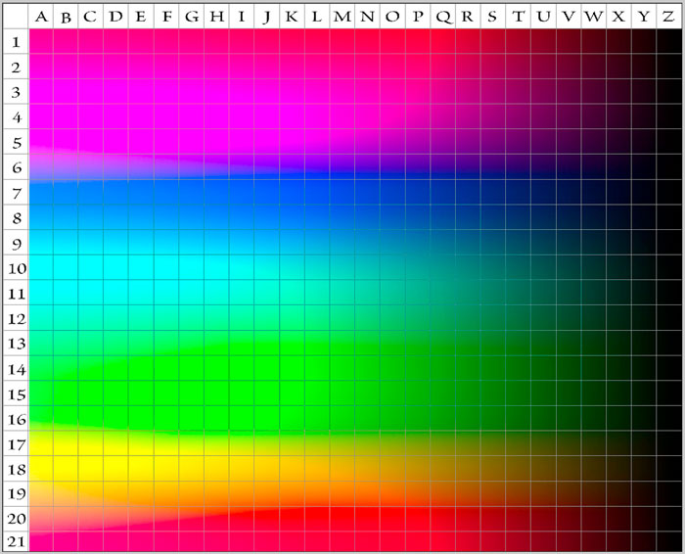
Digital Negatives
By printing this onto transparency film then exposing through it, one can determine the location where the light was most efficiently blocked.

Slide 16
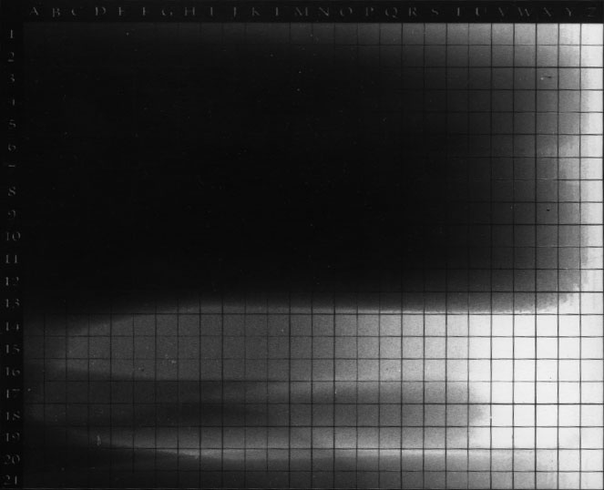
Digital Negatives
I then added a Threshold layer.

Slide 17
Digital Negatives
I then moved the slider so that only the smallest portion of white was showing.

Slide 18
Digital Negatives
That white area blocked light the best. I zoomed in on the area and used shift-Dropper-click to mark the best location.

Slide 19
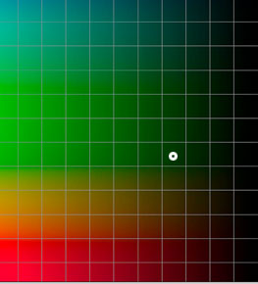
Digital Negatives
The location can be read by hiding the Threshold layer, then go back to the spectrum image and match the location to get the color. Another way to do this is to add the spectrum image as a layer, reduce the opacity of the layer, position the layer so that it exactly matches the scanned print below, bring the opacity back to 100%, and use the dropper to read the color. In this case the value was #003200.

Slide 20
Digital Negatives
So far we know that we will need to expose the paper for 16 seconds and that the color of the negative should not be black, but should be #003200. I am accustomed to making red negatives for use with silver gelatin paper but this Slavich paper wishes that paper to be green – so be it.
The only thing remaining is to build the curve.

Slide 21
Digital Negatives
Building a Curve
Matching the tonality of what is seen on the monitor with that of the paper is accomplished by applying a curve to the image. Determining the values of the points on the curve is done by testing specific values on a step tablet.
Myth: One can use a curve built by someone else.
There are so many variables involved in the production of a print – paper, developer, water, water temperature, and so on – that can affect the outcome that it is too much to hope that someone else will have those same values. As I will note toward the end of this presentation, it is very difficult to keep those variables consistent. In the past I have suggested that another’s curve may work well as a starting point, but I honestly no longer see this as an advantage, and starting with a straight line is equally fine.

Slide 22
Digital Negatives
You can make your own step tablet or download mine at http://glsmyth.com/articles/step-tablet.tif

Slide 23
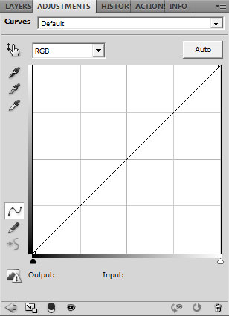
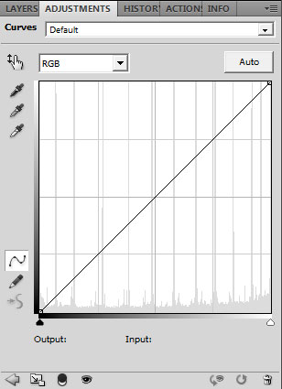
Digital Negatives
On the left is a blank curve, on the right is the curve associated with this step tablet. Note the spikes in the histogram on the right. These represent the tonalities of the step tablet values.

Slide 24
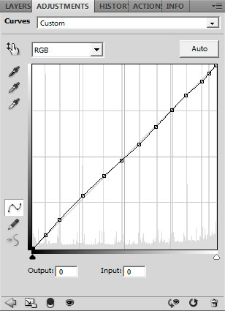
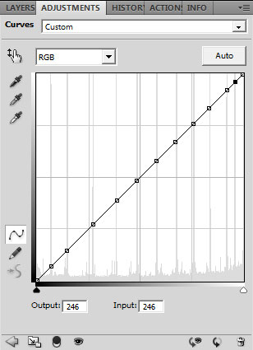
Digital Negatives
Click on each of these locations on the curve to establish its location, then Shift + to select each location, and the use the arrow keys to straighten things out. The Output and Input values of each should be equal.

Slide 25
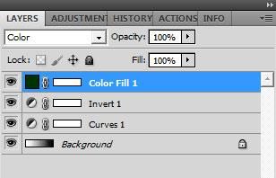
Digital Negatives
In a perfect world this step tablet would be printed, scanned, and the measurement of each segment would equal the number displayed within the segment.
We do not live in a perfect world.
What we will do is to find out how far apart each value is, then adjust it using the associated point on the curve.
Before printing, we need to add a few layers to the step tablet:
Curves
Invert
Color Fill
Change the Blending Mode of the
Color Fill layer to “Color.”

Slide 26
Digital Negatives
As the step tablet will be contact printed with the printed side placed against the paper, the image canvas needs to be flipped horizontally. My printer driver can so this automatically, so this convenience should be checked with your printer driver.
After printing the step tablet the scanned step tablet looks like this.

Slide 27
Digital Negatives
Disclaimer:
Two issues here.
While almost everyone will be contact printing, I am actually using my negatives for projection within the enlarger. As I am working with the Bromoil process, any dot pattern that may be evident is masked by the process.
I goofed with the printer driver when putting this together by not changing the print quality value from 1400 to 2880 dpi, so a dot pattern can be seen in these step tablet results. Upon realizing this, I made the correction before making the final print for this presentation, and even though projecting a 4x5” negative to make an 8x10” print, no dot pattern can be seen on the print, so this is not to be a concern, especially for those who are contact printing.
Data point: If you plan to use digital negatives for both contact printing and projected printing, realize that the two will yield different results. A curve will need to be established for each.

Slide 28
Digital Negatives
With the Dropper tool set to a Sample Size of 11x11 Average (there is too much variability when it is set as the default Point Sample) we measure each segment. The only problem is that at this point the 0% segment of the scanned step tablet measures 12% and the 100% segment measures 89%.
No paper base is perfectly white and D-Max is never perfectly black. Again, we do not live in a perfect world. Since we have previously tested our paper to make sure that the exposure will offer the deepest black available, that point should be considered to be the 100% mark. The paper base should be considered to be the 0% mark. We make this happen by applying a Levels layer to the scanned step tablet image.

Slide 29
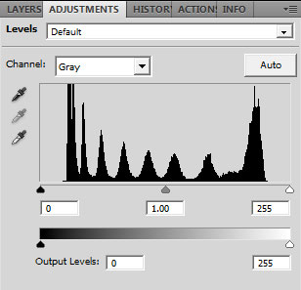
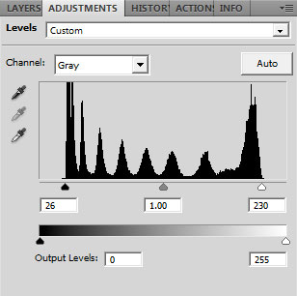
Digital Negatives
Below is the Levels layer as initially applied.
By moving the sliders to
the points where the
histogram indicates
the endpoints of tonality,
the 0% and 100%
points can be established
for measuring.

Slide 30
Digital Negatives
Now that we have made paper white the 0% point and 100% the point of deepest black, we can see why the print offered at the beginning of the presentation looked so bad – there is very little information in the mid-tones.

Slide 31
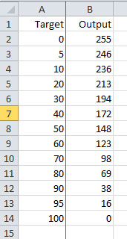
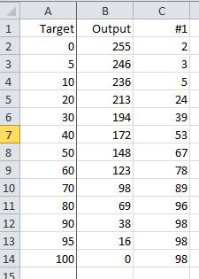
Digital Negatives
I use an Excel spreadsheet, but there is no reason not to do this on a piece of paper. I create a column with the target measurement for each segment and a column with the Output value currently associated with it.
Using the Dropper tool, each segment
is measured and placed into a third
column. It is my goal to get within
a couple percent of the target
value within each segment. The 0% and
100% end points would measure closer
if I had moved those points in the Levels
layer closer, but this is fine.

Slide 32
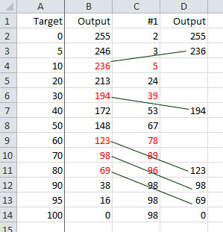
Digital Negatives
Now we start to work with the curve. The end points will remain the same, so they will not be altered. (Actually, I have encountered cases where the ultimate white point ends up with a value less than 255, so while this is not common, it should be kept in mind as a possibility).
As bad as things looked with the initial measurement,
there is plenty of useful information available. Note
that the measurements in some segments are quite
close to the target values in others. In these cases
we simply move those values into a new column.

Slide 33
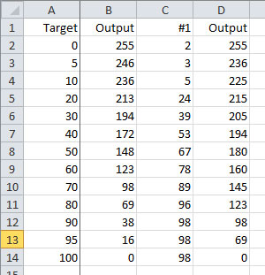
Digital Negatives
Some other guesses can be made by averaging some known values. For instance, the measurement of 40 is 53 and the measurement of 50 is 67, so 60 is in the center of those values. Therefore, my guess for 60 is going to be (148 + 172) / 2 = 160. By doing this a second set of guesses can be made.

Slide 34
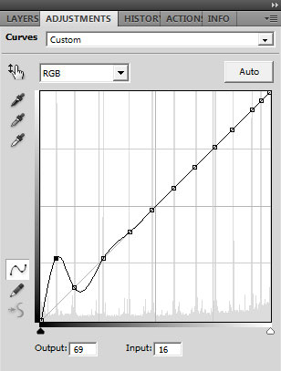
Digital Negatives
Returning to the curve, Shift + selects the first
adjustment point, which will remain as is, then
Shit + selects the second adjustment point,
which needs to be moved from 16 69.
Use the Up arrow key to make the adjustment.
Continue using Shift + to go to each
adjustment point and make the change.

Slide 35
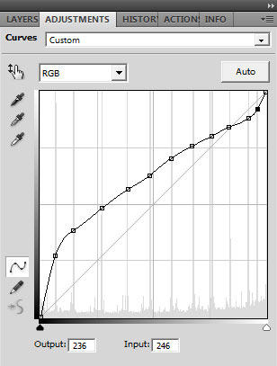
Digital Negatives
The completed curve.

Slide 36
Digital Negatives
At this point it is a matter if iteration:
Print the negative
Scan the print
Measure each adjustment point
Compare the results
Update the curve

Slide 37
Digital Negatives
The second test strip looks considerably better. Whereas previously the 0-10% and 80-100% segments looked almost the same, there are now some differences. Again we measure.

Slide 38
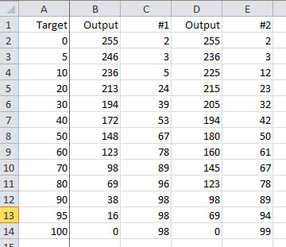
Digital Negatives
I have done enough of these to know that
sometimes one gets lucky, and this was one
of those situations. Most of these values are
within a couple percent of there they should
be. It normally takes me several iterations
before getting to this point.

Slide 39
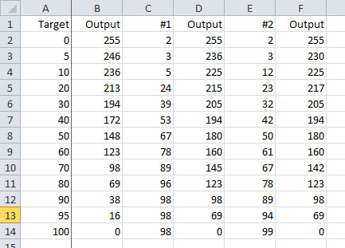
Digital Negatives
At this point I guessed new values
and updated the curve. With things
being this close I had the confidence
that the curve had been properly
established, so it was time for a
reality check.

Slide 40
Digital Negatives
Working with a step tablet and working with raw data takes ambiguity out of the situation. This allows one to keep focused not on the judgment of what something looks like, but on the technical aspects of the situation at hand.
However, our end goal is not to print step tablets, but to print images, and that is where the acid test resides.

Slide 41
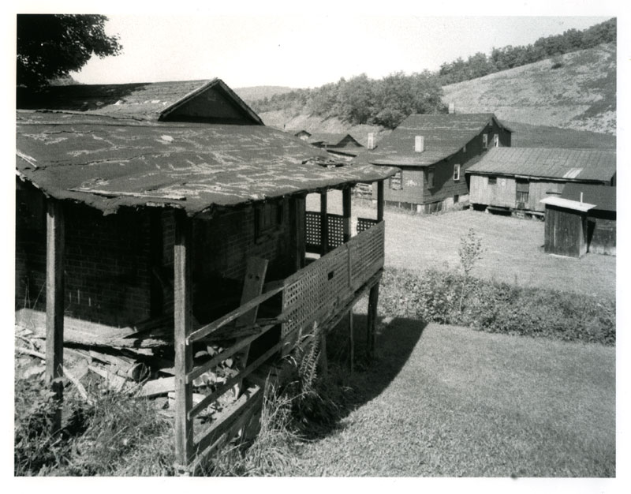
Digital Negatives
This print was made using the curve and color that were determined in this presentation. It appears very close to the image as it appeared on the monitor, so I’ll call it a success.

Slide 42
Digital Negatives
Dealing With Failure
When I started making digital negatives I was insistent upon getting the measured values to exactly correlate with their target values. After a full afternoon of testing I would give up and accept “good enough.” I never did get to the point where any of my curves were exact, but was able to get excellent results when making prints.
It took me quite some time to realize that in the analog world the act of exact repeatability is close to impossible. I decided to run a test to temper my expectations.
I printed a step tablet and set it aside. Several days later I printed the same step tablet. Measurements showed that the two were close, but not exactly the same. I do not have temperature stabilization for my print developer, so the varying ambient temperature in my darkroom may have been the issue – who knows? The two test strips looked very much the same, they just measured differently.
Now if I am within a couple percent of the target value, I do not sweat it.

Slide 43
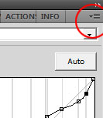
Digital Negatives
Finishing Up
One does not normally go through all of this testing to make a single print - the idea is that tomorrow, next week, or next year, prints will be made through these efforts. As long as everything in the process remains the same, the results should be perfectly acceptable.
Many people are not aware of the ability to save curves in Photoshop, as this is not something often needed.
To save the curve for later use, click the option list in the upper right corner.
From the drop-down select Save Curves Preset.
You may as well get specific with the filename to make it easy to recall
(the same option drop-down is used to load a saved preset). Once you have
built several curves you do not want vagueness making it difficult to figure out which curve you should be using.

Slide 44
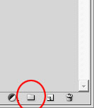
Digital Negatives
Better Yet
The digital negative color and curve are intertwined and need to stay together. You can keep a spreadsheet with this information or better yet, keep them together in a folder.
I keep the levels that are associated with the digital negative – curve,
inversion, and color – within a folder that can be created through an
option at the bottom of the Layers palette. Holding the layers within a
folder allows one to separate this information from the layers that deal
with the processing of the image.
Another advantage is that with a click of the eyeball the folder can be removed from display, so that when the file is saved the thumbnail (in Bridge or whatever program is being used to organize your files) will show the image.
Yet another advantage is that folders can be established for multiple processes, perhaps one for a silver print, one for Cyanotype, and one for Platinum.

Slide 45
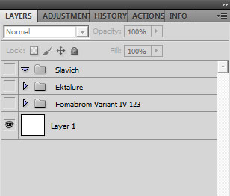
Digital Negatives
But that’s not all, there’s even more!
Perhaps the best reason to hold this information within a folder is that fact that one can create a Photoshop file with just folders of digital negative layers. When it is time to make a digital negative simply load the file into Photoshop, then drag the appropriate layer onto the image for which a negative needs to be made.

Slide 46
Digital Negatives
Final Thoughts
Like anything new, digital negatives go through the standard stages:
Is this something I can use?
This is so confusing
I finally understand it
This is going to open up possibilities for me
Digital negatives take a few moments to comprehend, but there is nothing here that cannot be accomplished by one with a rudimentary understanding of Photoshop. Once learned, the workflow of making a print can be made more efficient. For those who work with alternative processes, images that were photographed without the specific process in mind can now use those negatives with improper contrast. And for those printing with platinum, there can be less waste of those very expensive chemicals.

Slide 47
Digital Negatives
If errors are found in this document or if you feel that anything could be explained better, then please do not hesitate to contact me.
George L Smyth
George.Smyth@gmail.com

